Slide 1

Traffic Flow Data Visualization Using PCA and t-SNE
2520030082 Bhavana Kondakrindi
2520030103 K.Poojitha Sai
Under the Esteemed guidance of
Shaik Asif
Assistant Professor, CSE

Slide 2

Abstract
Traffic congestion is a major challenge in modern transportation systems, resulting in increased travel time, fuel consumption, pollution, and economic losses. Traffic-flow datasets contain multiple features such as speed, density, flow, occupancy, waiting time, and other traffic-related parameters, making them difficult to visualize directly. This project applies Principal Component Analysis (PCA) and t-Distributed Stochastic Neighbor Embedding (t-SNE) to reduce the dimensionality of traffic-flow data and visualize hidden patterns. PCA provides a compact linear representation, while t-SNE preserves local relationships and helps reveal clusters. The visualizations are used to analyze different traffic states and identify congestion patterns.

Slide 3
Introduction
  Traffic congestion is one of the major problems in urban transportation.
  Increasing vehicle numbers lead to longer travel time, fuel consumption, pollution, and economic losses.
  Modern traffic datasets contain many variables such as:
  Vehicle Speed
  Traffic Density
  Traffic Flow
  Occupancy
  Waiting Time
  Queue Length
  High-dimensional traffic data is difficult to understand using conventional visualization.
  Dimensionality reduction helps transform complex data into a simpler visual representation.
  This project uses PCA and t-SNE to visualize traffic patterns and congestion states.

Slide 4
Existing System
Traditional traffic-state analysis generally relies on:
  Individual traffic indicators such as speed, flow, density, and occupancy.
  Statistical analysis and conventional visualization.
  Clustering techniques for identifying traffic states.
  Direct analysis of high-dimensional traffic features.
Limitations
  Difficult to visualize many features simultaneously.
  Redundant/correlated traffic features can increase complexity.
  Conventional clustering can become difficult with high-dimensional data.
  Nonlinear relationships between traffic features may not be clearly visible.
  Hidden traffic patterns may be difficult to identify.

Slide 5
Our proposed system uses PCA and t-SNE to visualize high-dimensional traffic-flow data.
Process
Traffic Dataset
↓
Data Preprocessing
↓
EDA & Feature Analysis
↓
Feature Standardization
↓
PCA
↓
2D PCA Visualization
↓
t-SNE
↓
2D t-SNE Visualization
↓
Compare Results
↓
Identify Traffic Patterns
Proposed System
Main Objective
To transform complex traffic-flow data into meaningful 2D visualizations and identify patterns associated with different traffic conditions.

Slide 6
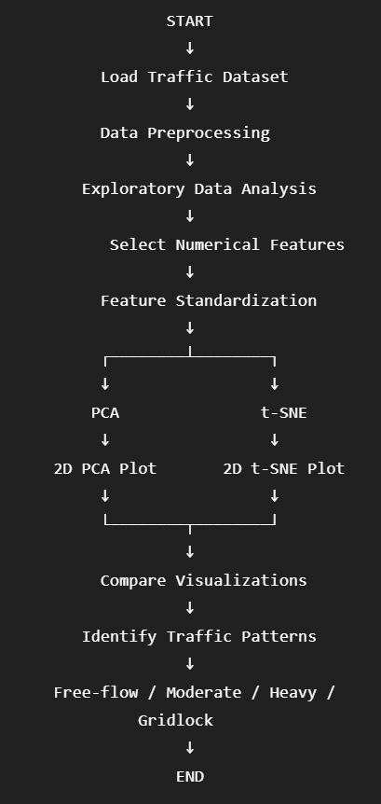
FLOW CHART

Slide 7
ALGORITHM
A. PCA — Principal Component Analysis
  Load the traffic dataset.
  Select numerical features.
  Standardize the features.
  Calculate the covariance structure.
  Determine principal components.
  Select the required components.
  Transform the data into lower dimensions.
  Visualize the first two components.
Purpose:
Reduce high-dimensional data while retaining maximum variance.
B. t-SNE
  Load standardized traffic features.
  Calculate similarities between data points.
  Preserve local relationships.
  Map the data into a lower-dimensional space.
  Generate a 2D visualization.
  Analyze the resulting clusters/patterns.
Purpose:
Reveal nonlinear relationships and local structures in high-dimensional data.

Slide 8
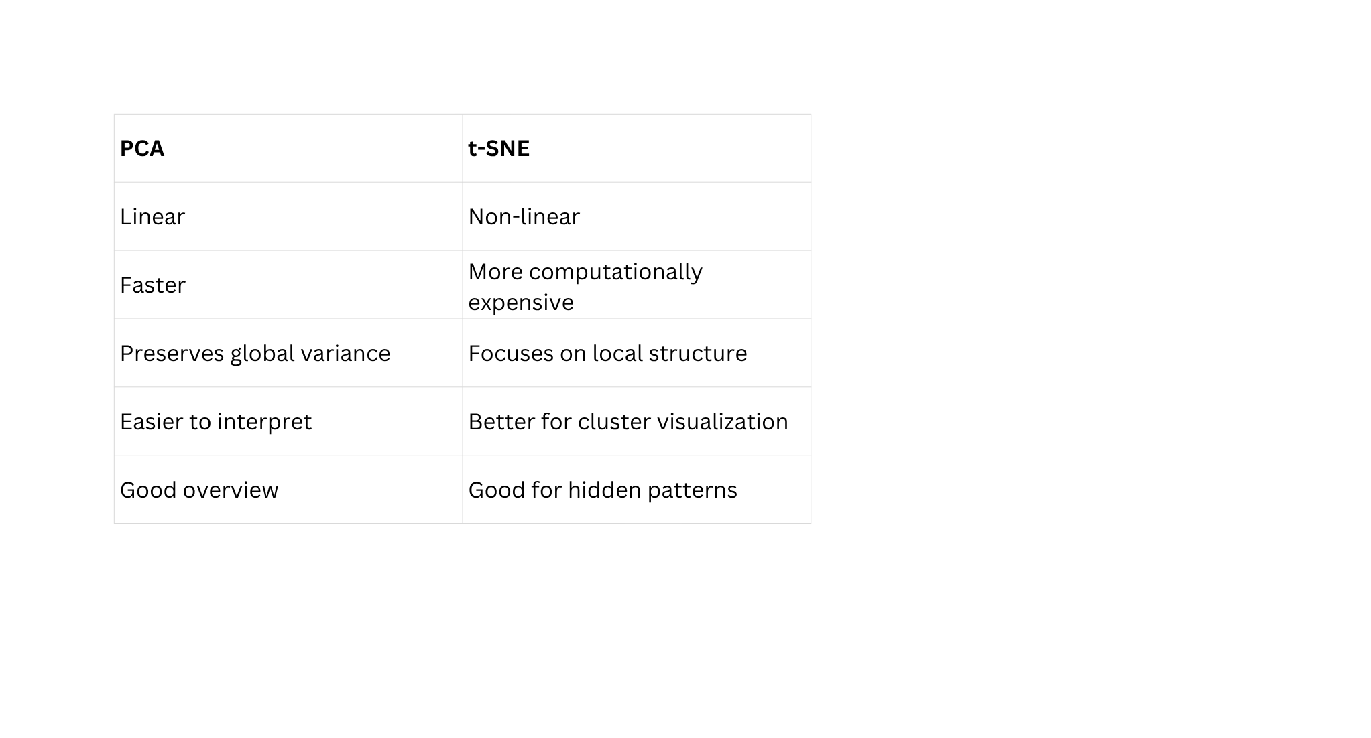
EXPECTED OUTPUT
1. PCA Visualization
A 2D scatter plot showing traffic observations according to their principal components.
2. t-SNE Visualization
A 2D scatter plot showing local relationships and possible traffic clusters.
3. Traffic Patterns
Identify patterns corresponding to:
🟢 Free-flow
🟡 Moderate
🟠 Heavy
🔴 Gridlock
4. Comparative Analysis

Slide 9
Conclusion
PCA provides an efficient low-dimensional representation of traffic-flow data, while t-SNE provides a detailed visualization of local traffic clusters. Together, the methods help reveal relationships between different traffic states and provide meaningful visual insights into congestion patterns.

Slide 10
Thank
You

